Slide 1


Slide 2
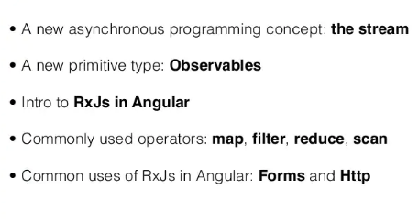
Angular RxJS
Angular
55

Slide 3
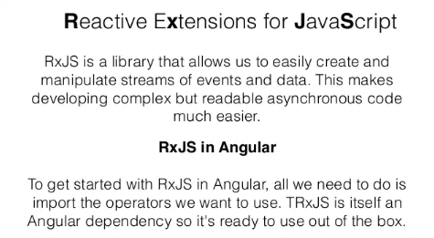
Angular RxJS
Angular
55

Slide 4
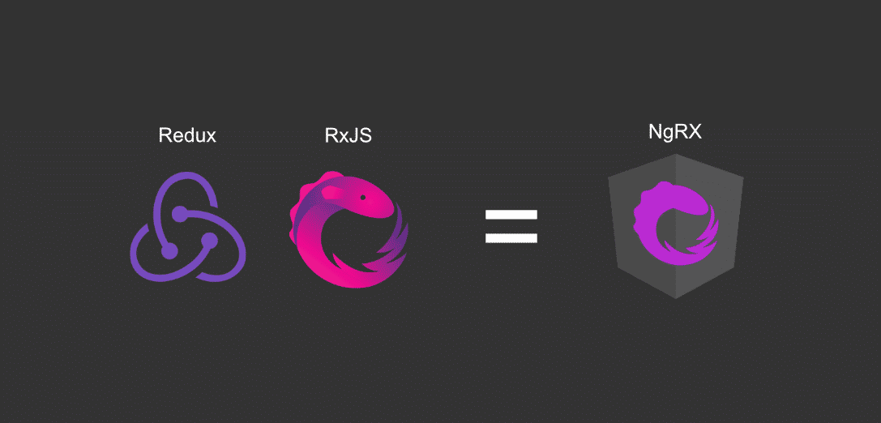
Angular RxJS
Angular
55

Slide 5
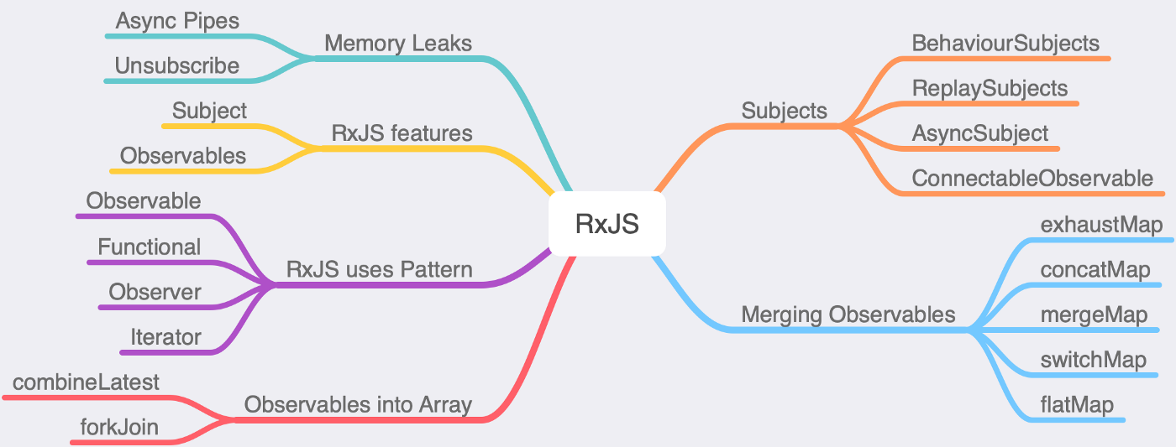
Angular RxJS
Angular
55

Slide 6
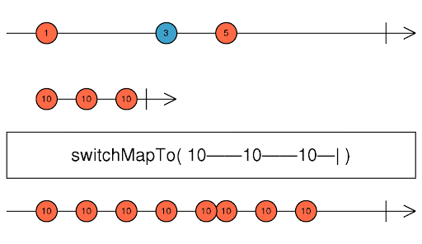
Angular RxJS
Angular
55

Slide 7
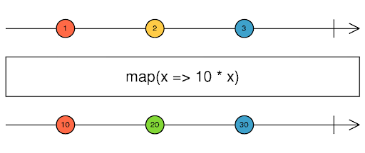
Angular RxJS
Angular
55

Slide 8
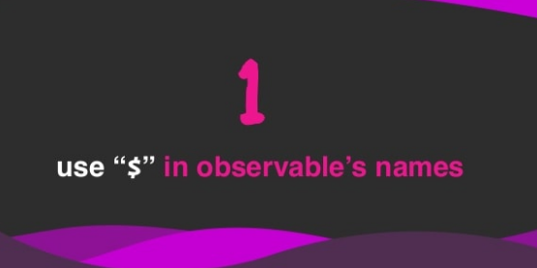
Angular RxJS
Angular
55

Slide 9
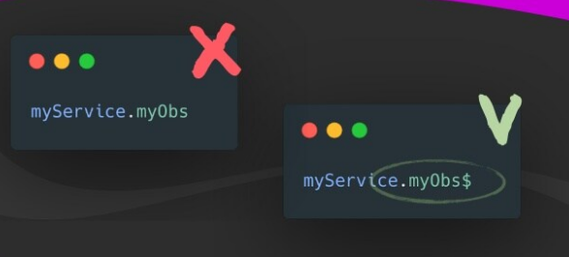
Angular RxJS
Angular
55

Slide 10
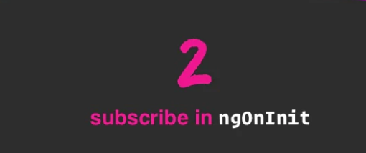
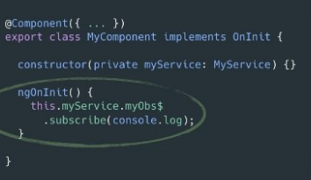
Angular RxJS
Angular
55

Slide 11
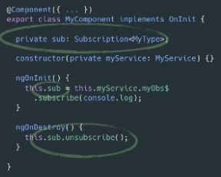

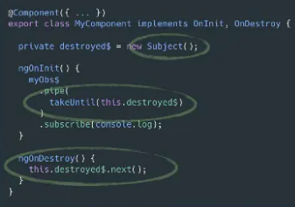
Angular RxJS
Angular
55

Slide 12
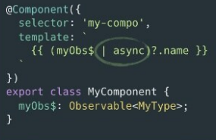
Angular RxJS
Angular
55

Slide 13
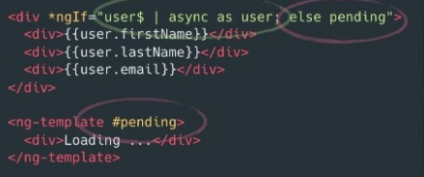
Angular RxJS
Angular
55

Slide 14
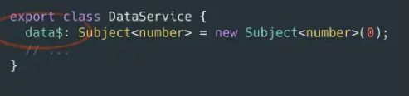
Angular RxJS
Angular
55

Slide 15
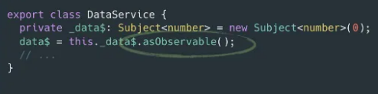
Angular RxJS
Angular
55

Slide 16
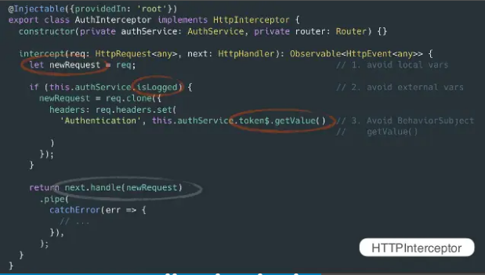
Angular RxJS
Angular
55

Slide 17
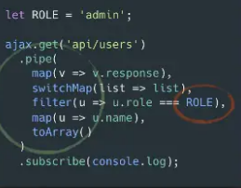
Angular RxJS
Angular
55

Slide 18
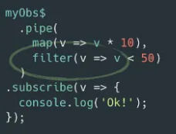
Angular RxJS
Angular
55

Slide 19
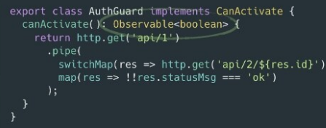
Angular RxJS
Angular
55

Slide 20
Angular RxJS
Angular
55

Slide 21
That’s All For Today Day-5 !!
Questions?

Slide 22
Thank You
shiva1991@live.com

